Slide 1
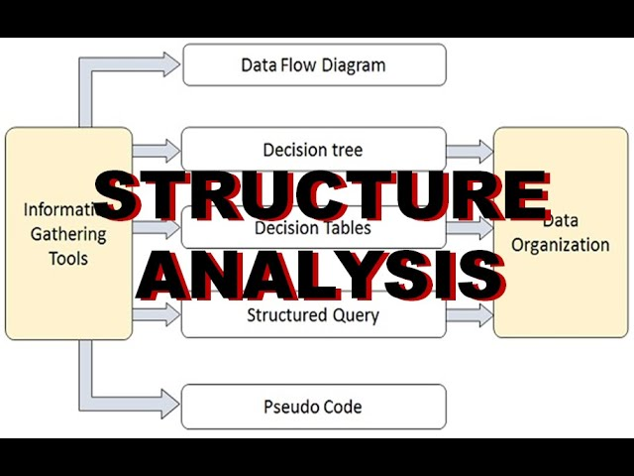
STRUCTURE ANALYSIS

Slide 2
Structured Analysis
It is a set of techniques and graphical tools that allow the analyst to develop a new kind of system that is understandable to the user
Why do we use these tools?
1.Use graphics whenever possible to help communicate better with the user.
2.Differentiate between logical and physical system
3.Build a logical system model to familiarize the user with system characteristics and interrelationships before implementation

Slide 3
DFD Symbols
• Square defines a source or destination of data.
• Arrow identifies data flow, means the data in motion. It is a pipeline through which information flows
• Circle or a bubble represents a process that transforms incoming data flow into outgoing data
• Open rectangle is a data store, or data at rest, or a temporary repository of data

Slide 4
Structured Analysis Tools
During Structured Analysis, various tools and techniques are used for system development. They are −
1.Data Flow Diagrams
2.Data Dictionary
3.Decision Trees
4.Decision Tables
5.Structured English
6.Pseudocode

Slide 5


